Slide 1
Remote Visual Health Checker for the Elderly
614410154 劉宇綸
614410123 湯鈞凱

Slide 2
Project Objective
The project aims to develop a remote visual health checker to initially assess the health status of the elderly by analyzing facial and tongue image indicators. The system is composed of multiple Python modules, including the main program wellness_checker.py responsible for integrating analysis results , face_analyzer.py focusing on facial feature analysis , and tongue_analyzer.py used for tongue-related indicator checks.
Notes:
Our project introduces a Python-based visual health checker for the elderly. By analyzing facial and tongue indicators,
It is composed of three Python modules.

Slide 3
Project Structure
wellness_checker.py | The main program, handling input/output, integrating analysis results, and generating summaries.
face_analyzer.py | Responsible for facial fatigue, skin color, tension, and symmetry analysis.
tongue_analyzer.py | Responsible for tongue color, coating, and moisture analysis.
README.md | Project description, installation, and usage guide.
requirements.txt | Python dependency list.
Notes:
wellness_checker.py responsible for integrating analysis results , face_analyzer.py focusing on facial feature analysis , and tongue_analyzer.py used for tongue-related indicator checks.

Slide 4
Face Analysis Techniques
Technology Name | Mathematical or Computational Method | Application
Eye Aspect Ratio (EAR) | Uses eye landmark points to calculate the ratio of the vertical distance to the horizontal distance of the eye. | Fatigue detection, blink rate calculation.
Color Space Analysis | Converts BGR image to RGB and calculates Saturation and Lightness for specific facial areas to judge whether skin tone is pale or flushed. | Skin color change detection.
Geometric Symmetry | Compares the difference in distance of a set of symmetric points (e.g., corners of the mouth, eyebrows) relative to the midline (e.g., tip of the nose). | Facial asymmetry detection (preliminary stroke screening).
Notes:
Eye Aspect Ratio (EAR) is applied to fatigue detection and blink rate calculation.
Color Space Analysis is applied to skin color change detection.
Geometric Symmetry is applied to facial asymmetry detection

Slide 5
Indicator | Analysis Method | Potential Significance
Fatigue | Calculates the Eye Aspect Ratio (EAR). Low EAR (< 0.2) and abnormal blink frequency (< 10 or > 30 times/minute) indicate fatigue. | Lack of sleep or physical discomfort.
Skin Color Change | Analyzes the average RGB values, saturation, and lightness of the cheek and lip areas. | Detects pallor (high lightness, low saturation) or purple/blue lips (low red, high blue).
Facial Tension (Discomfort) | Checks eyebrow position (whether raised) and corners of the mouth (whether strained or asymmetric). | May indicate discomfort or pain.
Facial Symmetry | Compares the symmetry of the eyebrows, corners of the mouth, and corners of the eyes relative to the tip of the nose. | A score < 0.85 is judged as asymmetric, used for preliminary screening of stroke symptoms.
Notes:
We calculate the Eye Aspect Ratio (EAR) to determine if the person is a lack of sleep or physical discomfort.
we analyze the average RGB values, saturation, and lightness of the cheek and lip areas to detect skin color changes
We check the position of the eyebrows to determine if the person is experiencing physical discomfort or pain.

Slide 6
Tongue Analysis Techniques
Technology Name | Image Processing Method | Application
Region Extraction | Uses lip landmark points to create a polygon mask to separate the Tongue Region of Interest (ROI) from the original image. | Tongue color, coating, and moisture analysis.
Tongue Coating Detection | Analyzes the Tongue ROI's Mean Brightness, Low Saturation, as well as the image's Standard Deviation (Texture Variation) and Edge Density. | Judgment of tongue coating thickness.
Moisture Assessment | Calculates the proportion of high-brightness pixels (> 200) within the ROI and combines it with image contrast. A high proportion and high contrast usually indicate glossiness and moisture. | Evaluation of tongue dryness.
Notes:
Region Extraction is applied to Tongue color, coating, and moisture analysis.
Tongue Coating Detection is applied to Judgment of tongue coating thickness.
Moisture Assessment is applied to Evaluation of tongue dryness.

Slide 7
Indicator | Analysis Method | Classification / Potential Significance
Tongue Coating Color | Analyzes the average RGB values, saturation, and lightness of the tongue region. | Differentiates among Normal, Pale, Red, or Purple. Pale and Purple are flagged as abnormal.
Tongue Coating Thickness | Assesses the coating score based on Brightness, Saturation, and Texture Variation (Standard Deviation). | Classified as None, Thin, Moderate, or Thick.
Moisture | Evaluates the Glossiness of the tongue surface by calculating the moisture score through the proportion of high-brightness pixels and contrast. | Classified as Moist, Moderate, or Dry. A score below 0.3 is detected as Dry.
Notes:
We analyze the average RGB values, saturation, and lightness of the tongue region to determine the tongue coating color.
We assess the tongue coating thickness based on Brightness, Saturation
We evaluate tongue surface moisture by calculating the contrast and the proportion of high-brightness pixels."

Slide 8
Health Summary and Output
Alerts：Used to flag high-risk findings, such as facial asymmetry (suspected stroke) or dry tongue coating.
Warnings : medium-to-low-risk findings,such as skin color changes or thick to
Output Format: Detailed analysis data and the summary will be saved as a JSON file

Slide 9
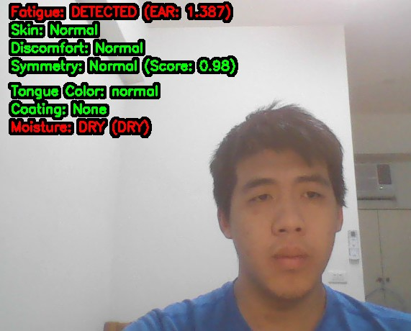
Results

Slide 10
Python Libraries
opencv-python>=4.8.0
mediapipe>=0.10.0
numpy>=1.24.0
Pillow>=10.0.0
graphviz>=0.20.0

Slide 11
THANKS FOR Listening

